Slide 1

DEPARTMENT OF COMPUTER SCIENCE Project Presentation (KCS 753) Rescue Route
Guide Name: Ms. Akanksha
(Project id- 40)
1.Nikita Sharma 8B(2000290120101)
2. Khushi Vaish 8B(2000290120086)
3. Kashish Gupta 8B(2000290120084)

Slide 2
Problem Statement
In today’s world we have been facing problem due to increasing traffic on roads. This causes a lot of waste of time and increases stress level. As many emergency vehicles are also stuck in traffic for hoursleads to losing life of people. So, this leads for creating a system which can intelligently handle traffic by itself modifying its timing in response to traffic density provide passage for ambulances using RCNN(Region-based Convolutional Neural Network), webcam, NodeMCU controller, LEDs. The core idea revolves around traffic management through the assessment of traffic volume on each side of the road, with the aim of implementing smart traffic signal control based on this density information.

Slide 3
Objectives
Optimize Traffic Flow: Develop a system that adapts traffic signal timings based on real-time traffic density data to alleviate congestion, reduce travel times, and enhance overall transportation efficiency.
Increase Ambulance Response Efficiency: Establish a priority mechanism to grant ambulances a red-light-free pathway, ensuring swift response to emergencies and enhancing public safety.
Reduce Environmental Impact: By minimizing traffic congestion and idling, contribute to lower emissions and reduced environmental pollution, thereby promoting a healthier urban environment.
Enhance Public Safety: Improve the safety of the public by expediting ambulance responses and minimizing the risk of delays during critical medical emergencies.
Improve Urban Transportation Infrastructure: Implement an innovative solution that enhances the functionality of urban traffic management systems, ultimately benefiting the quality of life and transportation experience for residents.

Slide 4
Technology Used
RCNN Algorithm
Real-time Data Processing
XML
NodeMCU
OpenCV
Tensorflow

Slide 5
Literature Survey
Real-time traffic density count using image processing.
Authors: Abbas, Naeem, Muhammad Tayyab, and M. Tahir Qadri.
Journal: International Journal of Computer Applications
Year: 2013

Slide 6
Summary
Abbas, et al. present a method for assessing lane-specific traffic density through the application of image processing. This approach offers distinct advantages, primarily obviating the need for costly aerial imagery and intricate sensor-based systems, thus rendering it a cost-effective solution. Notably, our system does not necessitate the installation of additional devices like RFIDs. Future improvements can include the incorporation of an emergency vehicle identification system, affording priority to such vehicles, and the integration of Vehicular Ad-hoc Networks (VANETs) to enhance road safety and contribute to the development of intelligent transportation systems.

Slide 7
Literature Survey
Smart traffic control system using image processing.
Authors: Jadhav, Prashant
Journal: International Research Journal of Engineering and Technology (IRJET)
Year: 2016

Slide 8
Summary
Jadhav, Prashant, et al. introduces a novel approach to estimate traffic, employing image processing on captured highway camera footage to count vehicles, issue warnings for heavy traffic if thresholds are exceeded, and offers cost-effectiveness, ease of implementation, and notable accuracy and speed compared to traditional sensor-based systems. It is executed using MATLAB and image processing, aims to alleviate heavy traffic congestion. It involves the utilization of web cameras positioned in traffic lanes to capture road images, which are then meticulously processed to gauge traffic density. Based on the data analysis conducted through MATLAB, the system commands traffic signal LEDs to display specific time intervals, facilitating traffic management.

Slide 9
Literature Survey
Density Based Traffic Control System with Smart Sensing Of Emergency Vehicles
Authors: D. M. . Varadharaj
Journal: International Journal of Computer Applications
Year: 2019

Slide 10
Summary
D. M. . Varadharaj employs switches, rather than magnetic sensors, to assess traffic density and modulate green signal durations based on this information, leading to the desired outcomes. Future project developments involve extending the system to manage all four lanes at a traffic signal by employing efficient PIC interfacing techniques. Furthermore, the system will incorporate the capability to detect emergency and government vehicles through the use of RF transmitter and receiver components, known collectively as an RF transceiver. The primary goal of the project is to optimize traffic flow by effectively utilizing green signal durations. In this system, the traffic density in a specific lane is determined by the count of magnetic sensors placed at the roadside, which generate output signals corresponding to the traffic density.

Slide 11
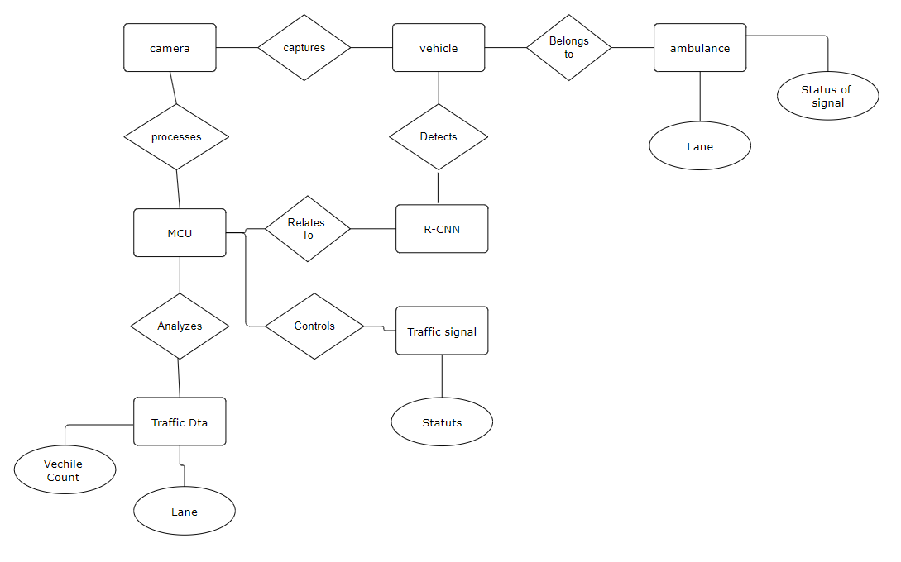
Diagrams
ER Diagram

Slide 12
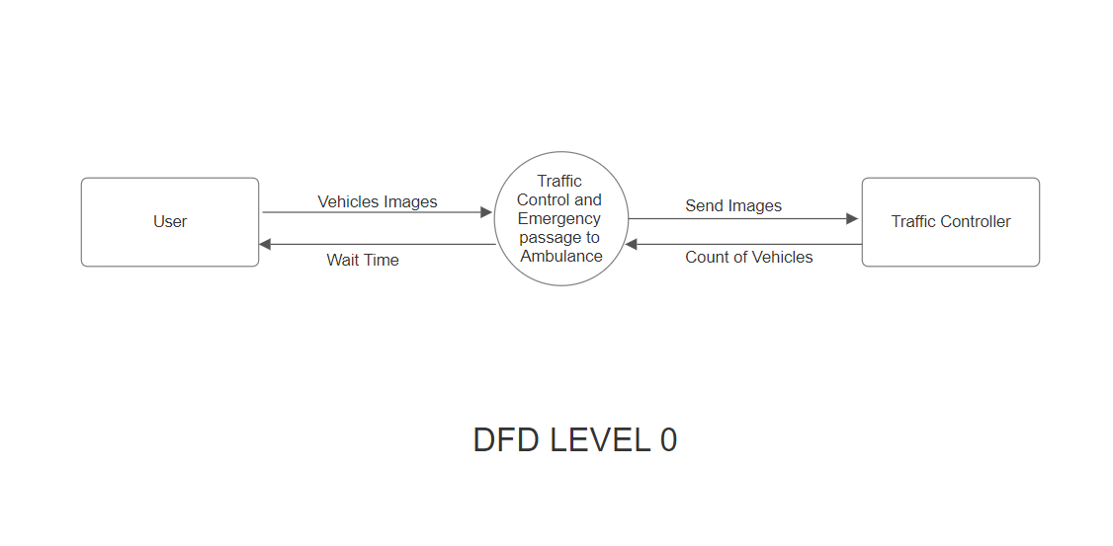
Data Flow Diagram

Slide 13
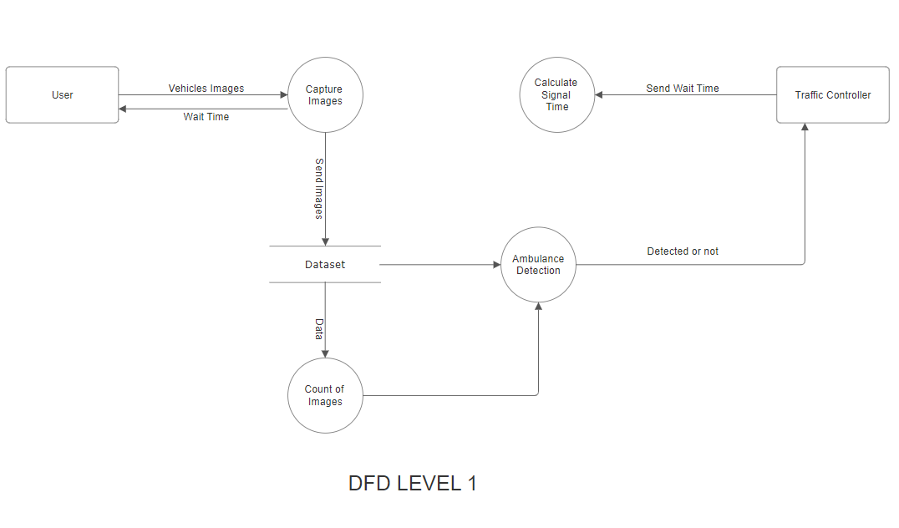

Slide 14
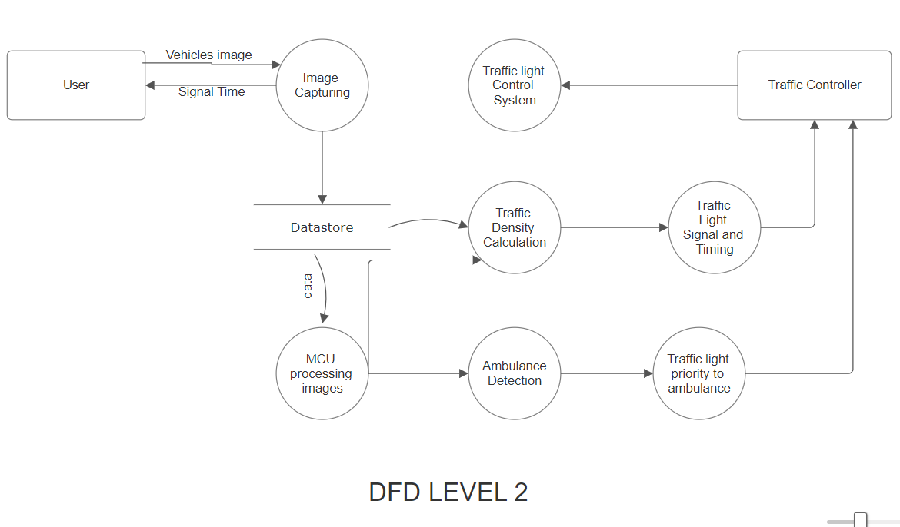

Slide 15
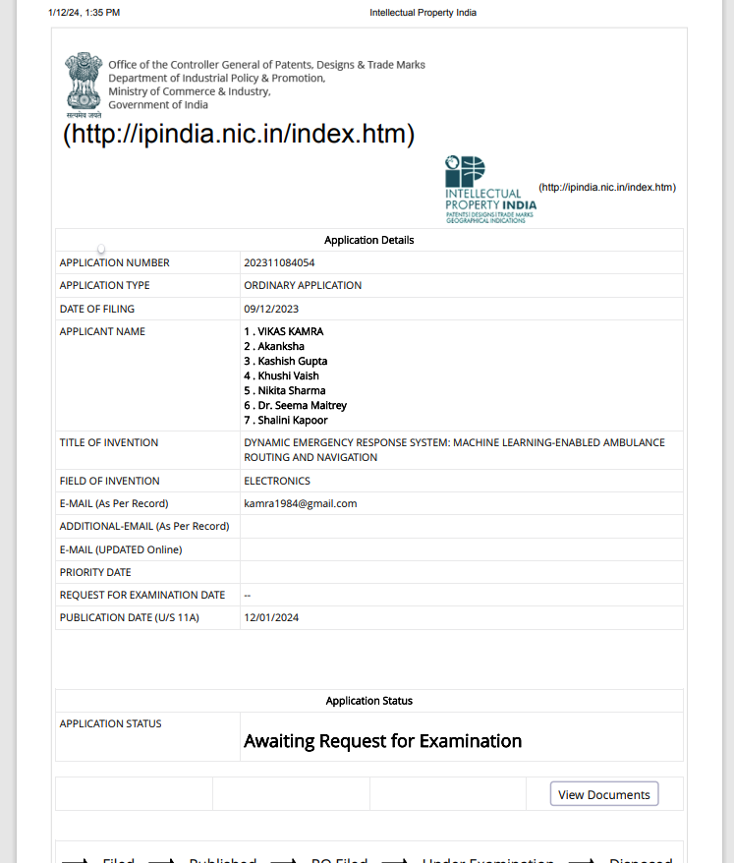
Patent Status
Published
Patent Published .pdf

Slide 16
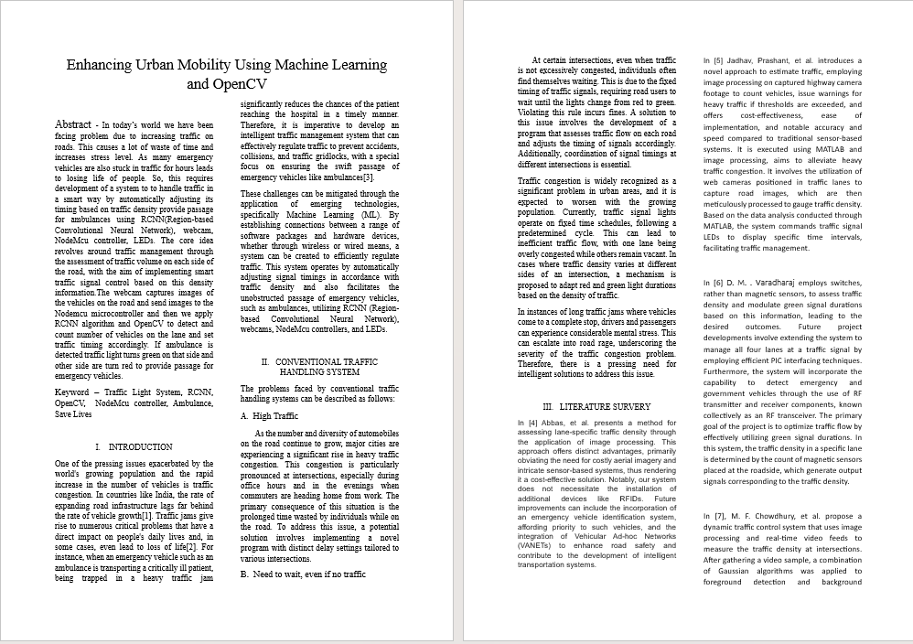
Research Paper Status
Paper Submitted

Slide 17

Submission Proof

Slide 18
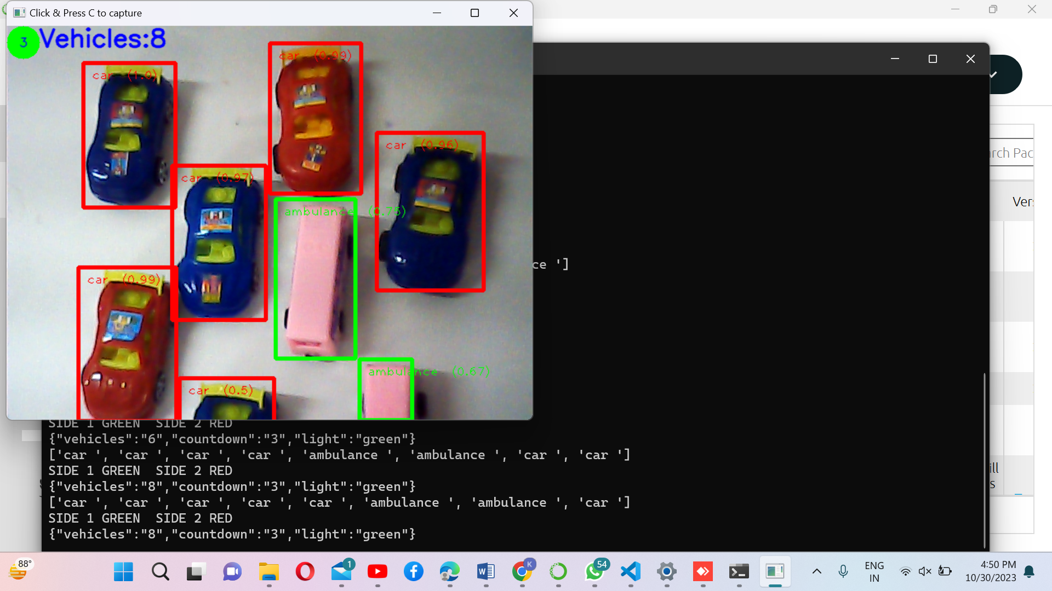
Project Status
100% Complete

Slide 19
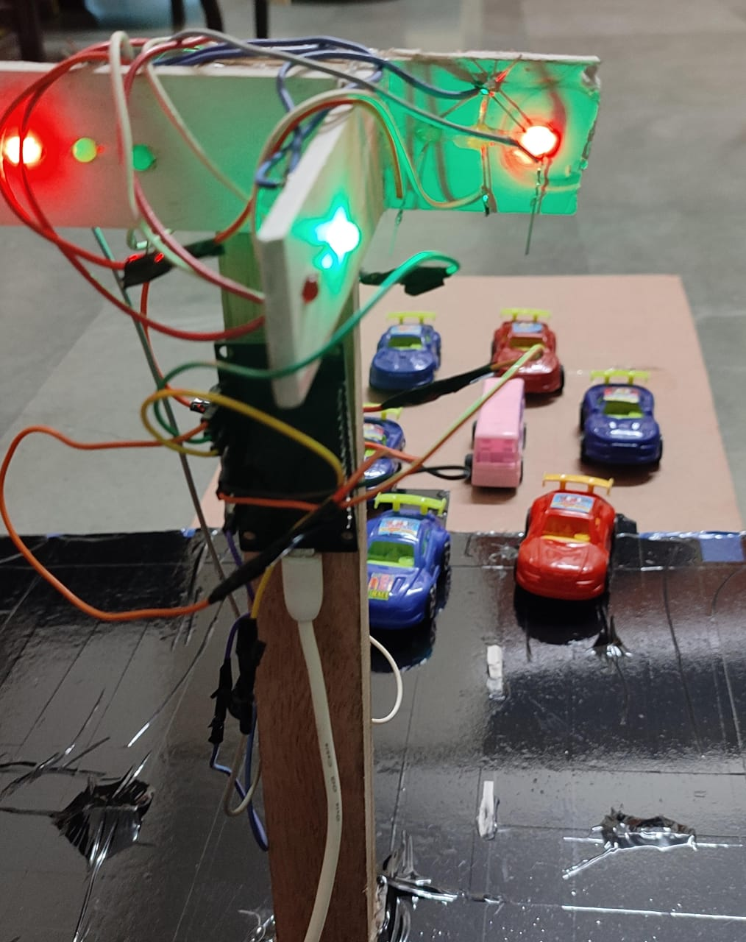

Slide 20
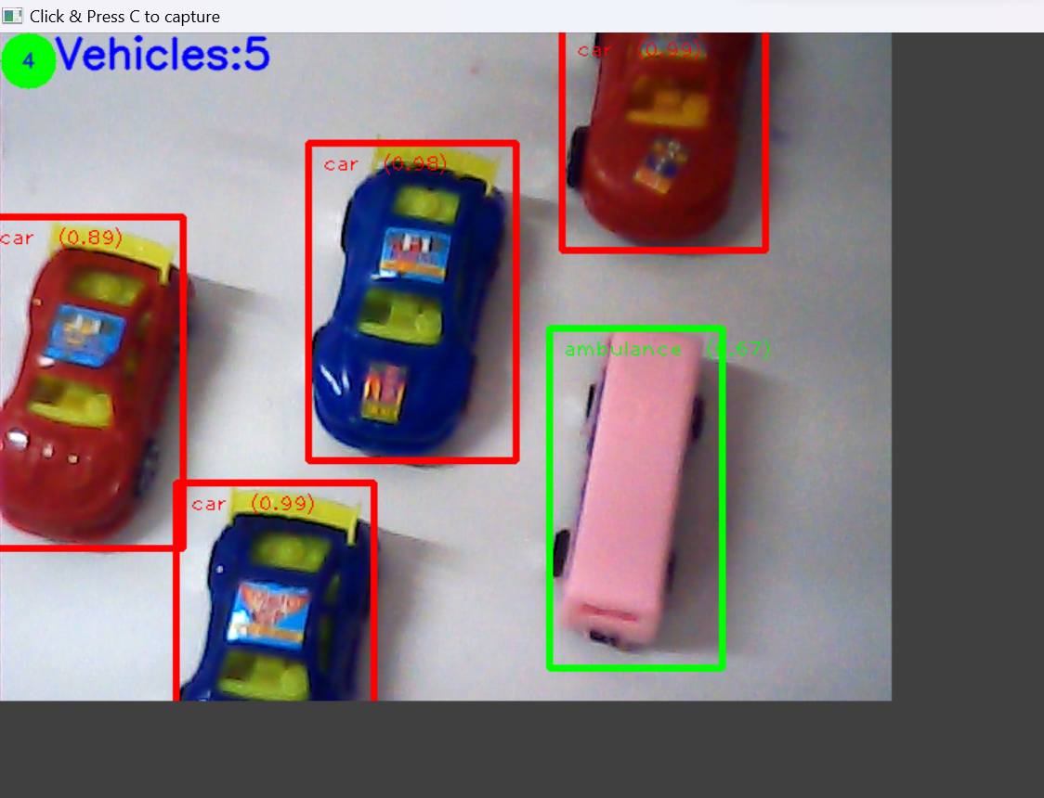
Project Status

Slide 21
Testing Report
 |  | TEST CASE TYPE: Traffic Flow
 |  | TEST CASE DESCRIPTION: To test the flow of traffic lights
TEST DESCRIPTION |  |  |  | EXPECTED RESULT |  |  |  | RESULT
Connect Setup(Webcam and NodeMCU) |  |  |  | Light up once connected |  |  |  | PASS
Flow the correct flow of traffic lights |  |  |  | Follow the sequence Green,Yellow and Red |  |  |  | PASS
Follow the time interval of traffic lights |  |  |  | Successful |  |  |  | PASS
 |  | TEST CASE TYPE: Ambulance Detection
 |  | TEST CASE DESCRIPTIPN: To clear lane for ambulance
TEST DESCRRIPTION |  |  |  | EXPECTED RESULT |  |  |  | RESULT
Ambulance Detection |  |  |  | Successfully detected |  |  |  | PASS
Green Signal If ambulance detected |  |  |  | Traffic signal turns Green until ambulance passes |  |  |  | PASS
If ambulance not present |  |  |  | Normal sequence according to count of vechicles |  |  |  | PASS

Slide 22

Thank you

